Slide 1

How can I open a similar venue in my local economy like the most popular from the Downtown?

Slide 2
I need some Data
Data from Mexico City
What did I Do?
I created the Data Frames with a web site and the Nominatim library. I called them ‘T’ and ‘C’.
I took a slice of each Data Frame in order to get the most popular neighborhoods. ‘TN’ and ‘CN’ Data Frames.
I did calls for the Foursquare API with the ’explore’ and ‘details’ endpoints.
1) The Data Frames with the coordinates of each borough that I want to analize: Tlahuac and Cuahtemoc.
2) The Data Frames with the most popular neighborhoods of each borough.
3) The Data Frames with the Foursquare features like rating.

Slide 3
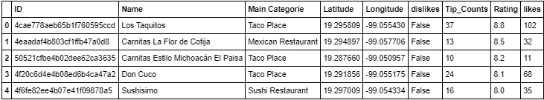
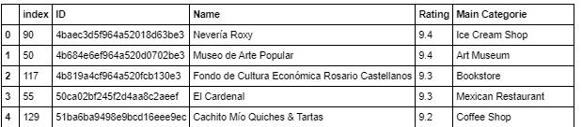
Here are the results
Tlahuac with features
Cuauhtemoc with features

Slide 4
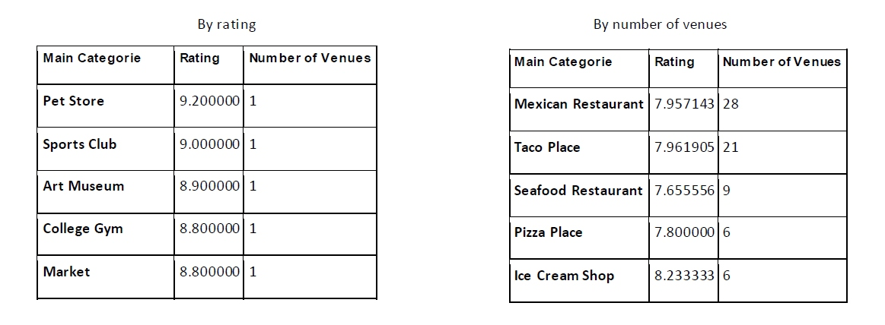
And now?
I need to get parameters from Tlahuac borough in order to choose a kind of venue from Cuauhtemoc borough.
The parameters are number of venues and rating. I don´t consider the ‘likes’ feature because there aren´t enough likes per venue.
I can sort the results by rating or by number of venues.

Slide 5
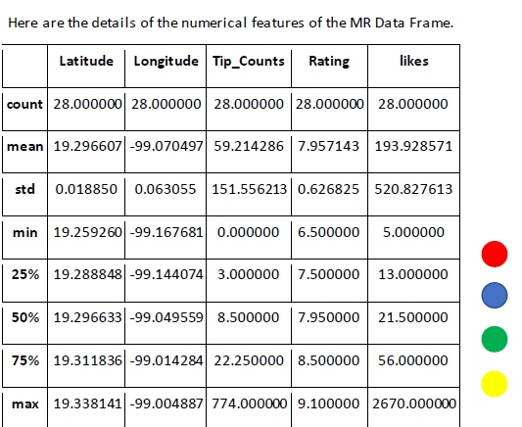
Choosing the Mexican restaurant categorie
Tlahuac has more Mexican restaurant venues than the other categories.
And Cuauhtemoc borough has a Mexican restaurant venue with a great rating.
I need a Data Frame (MR) with the Mexican restaurant venues in Tlahuac and the numerical info.
Where are the most popular venues in this Data Frame?

Slide 6
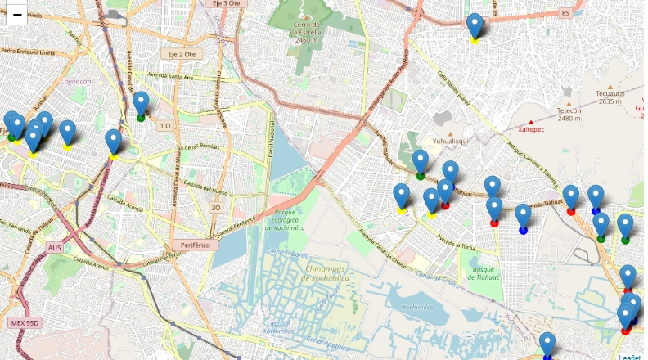
MR map with color marks

Slide 7
Discussion about Mexican restaurant venues
In Mexico City the boroughs that are nearest from the Downtown have a better economy. So, it avoids to open better venues.
There are two regions. The left region has the most popular venues in the Mexican restaurant categorie. The right region has the worst.
Only two good places exist in the right side. This situation is very interesting. In fact, it could be a good opportunity.
The venues in the left side in fact are very far from the Tlahuac Borough.
I know now that the people who rate these places prefer the Mexican venues without the Tlahuac borough.
It seems if you open a similar restaurant like the Cardenal restaurant in the Tlahuac borough and you try to connect your venue with the main venue browsers you can earn the attention of the persons who are not happy with restaurants near the borough.

Slide 8
Conclusions about report
The notebook and the report are very useful. You can know how to start If you want to open a venue near the Tlahuac borough. I know, there are many others features that I need to consider,
Many venues are not registered in Foursquare. Maybe with other site with API I can get more detail information in certain region. Also, many venues in Tlahuac borough don´t use the social media ways to get better promotion.
The check-ins are very important. Maybe the rating could be high, but if you don´t have enough registers, that information could be not very relevant.
.
A good idea of business is to offer social media services in the Tlahuac borough.
Tlahuac doesn´t have variety. It´s enough with see the Data Frames. The most common kind venue is food.
If a categorie has one venue and that venue has a high rating, you should investigate more about it even there are not enough information about the check-ins.

